Slide 1
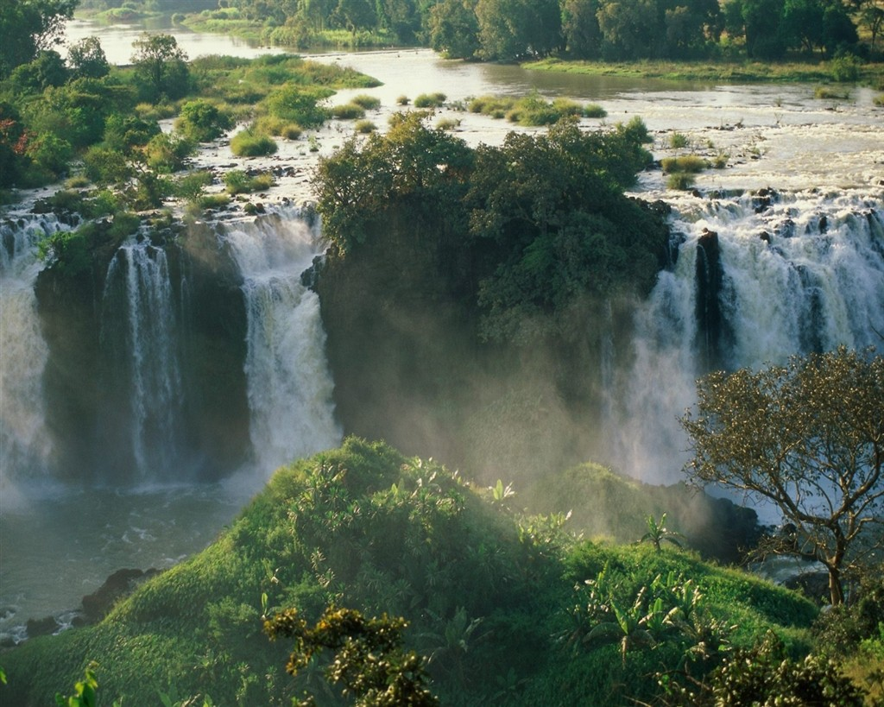
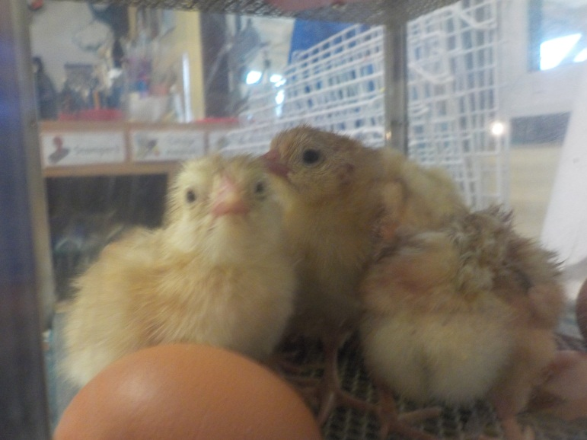
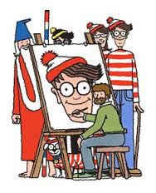
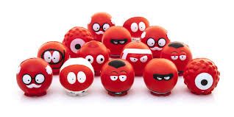
WHISPERER SPRING
Chicks
RED NOSE DAY
JOKES

Slide 3
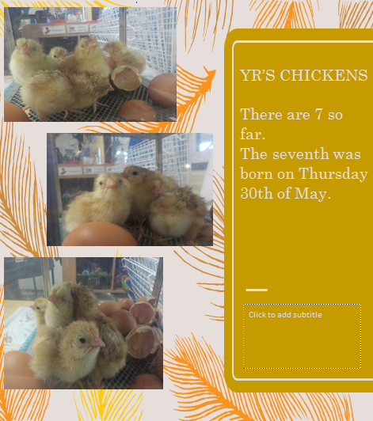

Slide 4
SUPER SPORTS
This year, we have been doing more than ever in the world of sports .
Gabe Dent, Patrick Griffin, Amelia Taylor and Melissa Kelly have been hosting events at playtime for all of the children.
☺☺

Slide 6
JOKES OF THE WEEK.
I USED TO WORK IN THE ORANGE FACTORY, THEN I GOT CANNED, I COULDN’T CONCENTRATE. THEN I GOT FIRED FROM THE CALENDER FACTORY, ALL I DID WAS TAKE A DAY OFF!
WHAT DID THE EARTH DO WHEN HE HAD TO THROW A PARTY FOR THE SOLAR SYSTEM?
PLAN-IT

Slide 9
WHISPERER SPRING
Chicks
RED NOSE DAY
JOKES

