Slide 1
Your School Nursing Service

Slide 2
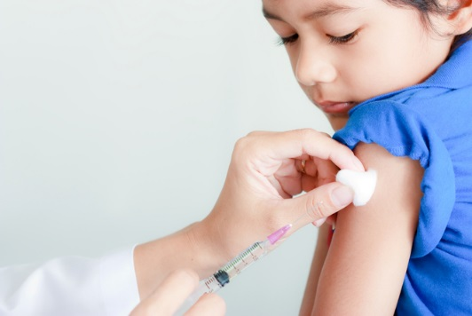
What does the School Nursing Service do?
Health promotion in schools
Support the emotional Health of school age children
Offer a 6 week intervention for bed wetting
Provide school age immunisations
Collect data for the National Child Measurement Programme (NCMP)
Vision and hearing screening
Supporting children in school who have severe allergies
Supporting children in schools with health issues

Slide 3
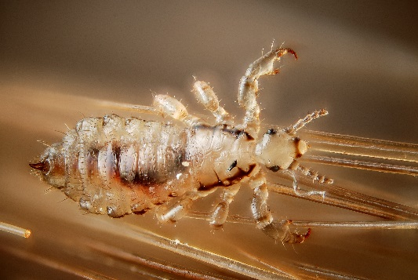
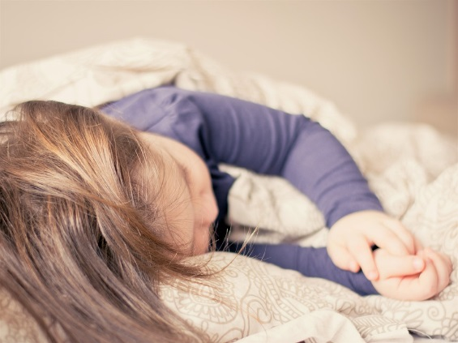
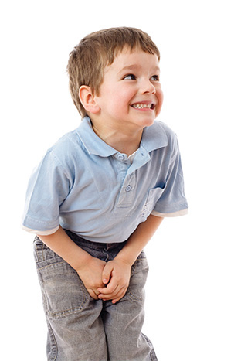
We can also offer support and advice on issues such as ….
Healthy eating / fussy eaters
Bed wetting / toileting
Sleep
Head lice
General health
Behaviour
Health conditions
Child development
Bereavement
Self esteem

Slide 4
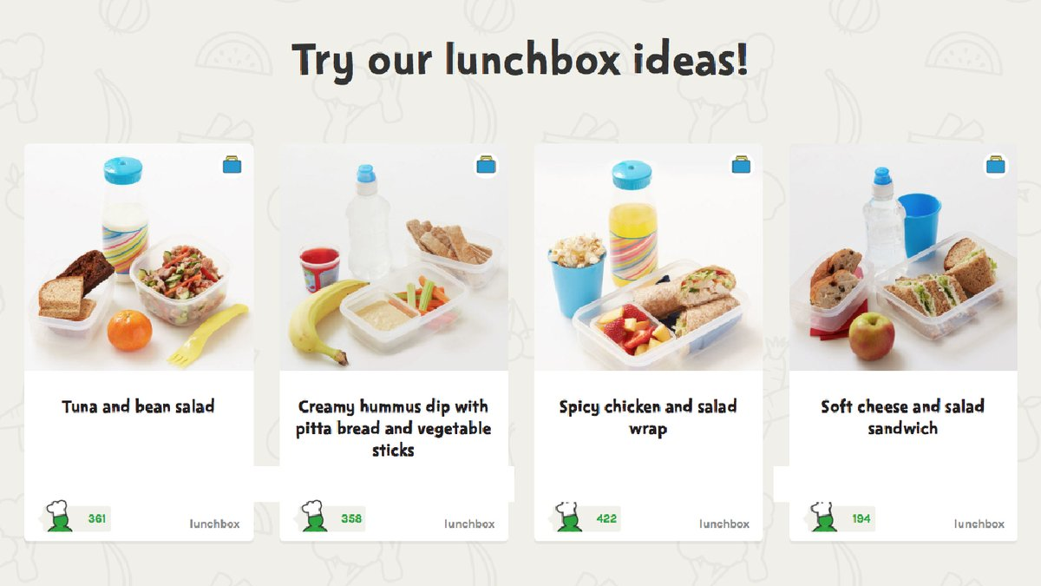
Healthy Lunch Box Ideas
Take a look at www.nhs.uk/change4life for more great ideas like these!

Slide 5
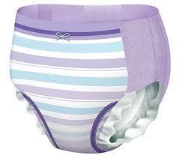
Bed Wetting Tips
Try to stop using pull-ups if you can. Your child can become reliant on these.
Make sure your child is getting enough fibre, a full bowel puts pressure on the bladder.
Avoid dark drinks such as
blackcurrant, cola and hot chocolate before bed, they can irritate the bladder.
Make sure your child is drinking enough through the day. 6-8 Glasses.

Slide 6
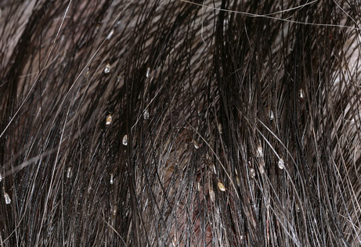
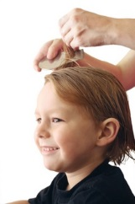
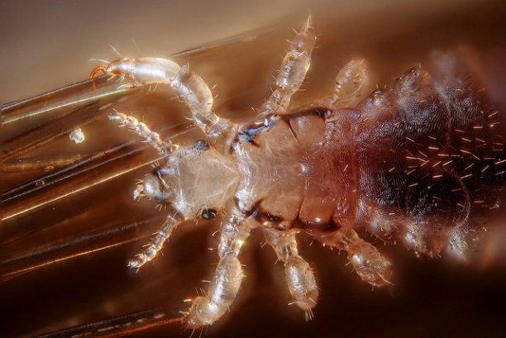
Head Lice Tips
Regularly comb wet hair with conditioner.
Make a habit of checking hair frequently
Let school know if you find lice, so they can inform other parents.

Slide 7
Vaccination Status
Please check your child is up to date with their routine vaccinations before they start school in September 2018.
Vaccinations protect children from several contagious and potentially serious diseases.
At school, children will be mixing with large numbers of other children in a confined environment, which increases the risk of germs (virus and bacteria alike) spreading.
Vaccination builds immunity to protect against illnesses and for a number of diseases, stops germs being spread, thus protecting the very vulnerable children who may not have been able to develop immunity.
We currently have an outbreak of measles across Avon, Gloucestershire and Wiltshire and outbreaks are also being seen in other parts of the UK along with large outbreaks across Europe. Measles is a highly infectious viral illness that can be very unpleasant and sometimes lead to serious complications.
The best protection is ensuring your child has 2 doses of the measles, mumps and rubella (MMR) vaccination.
If you are not sure if your child has had all their routine vaccinations, check their personal health record (Red Book) or contact your GP surgery. For a checklist of the vaccines and the ages at which they should ideally be given visit www.nhs.uk/vaccinations

Slide 8
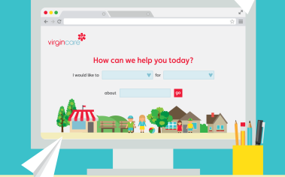
How to contact your School Nursing service
On our website www.wiltshirechildrensservices.co.uk
Or call our Single Point of Access on 0300 247 0090

