Slide 1
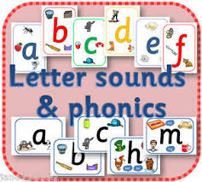
An Introduction to Phonics at Ashton Keynes Primary School.

Slide 2
Phonics is the gateway to successful reading and writing.
A passport to literacy success.

Slide 3
I will be:
Giving you a whistle stop tour of phonics!
Explaining the methods we use to teach phonics.
Giving you ways to help support your child at home with phonics and reading.
Answering any questions about phonics.

Slide 4
In Class R we teach phonics every morning after play.
During each phonics lesson there will be:
Whole class teaching in which a new sound or new words are introduced.
Adult led phonics activities with groups of children.
Independent, play-based phonic activities inside and outside including star challenges!

Slide 5
At Ashton Keynes we teach phonics using a six phase teaching programme called Letters and Sounds.
This is a systematic approach which will continue until the end of Year 2.
In the Foundation Stage we also use Jolly Phonics to introduce the individual sounds to the children.

Slide 6
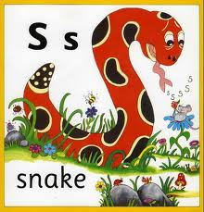
Jolly Phonics
Jolly phonics is a multi sensory approach to introducing letter sounds.
The individual sounds are introduced using a story.
Each sound is accompanied by a song and an action.

Slide 7
Where we began....
During the first two weeks we continued to develop the phase 1 skills already introduced at preschool.
Tuning into sounds
Listening and remembering sounds
Talking about sounds
From week 3 we introduced phase 2:
Introducing the first 19 sounds (4 per week )
Blending and segmenting to read and spell CV (consonant vowel) and CVC (consonant vowel consonant) words
Reading some High Frequency words and some tricky words

Slide 8
Although there are 26 letters in the alphabet there are 44 speech sounds in the English language.
Pronunciation
As soon as children are able to recognise 4 or more sounds, we will encourage them to blend the sounds together to form words.
Sound fingers
Sound buttons
P e t

Slide 9
Sound Fans
Your child will have received a sound fan with the sounds we have learnt so far.
Please encourage your child to play with the fans and begin to blend the sounds together to create words.
Each Friday your child’s fan will have new sounds added to it. Please ensure it is kept in their bag at all times.

Slide 10
And then...
We will move onto phase 3 whilst continuing to recap and build upon the skills already learnt in phase 2.
The children will begin to learn the 25 more complex 2 and 3 letter sounds which will be added to their sound fans.
They will be blending one and two syllable words and reading captions and sentences.
They will be writing words and captions and practising letter formation skills.

Slide 11
Reading Books
Soon your child will come home with two reading books to share with you.
Some books will have no words to encourage your child to tell the story themselves.
Some books will have simple text which initially you will need to read to your child.
You can encourage them to point to the words as you read, spot sounds they recognise and blend very simple words.
Gradually they will take over and begin to read themselves.

Slide 12
The reading books are arranged in coloured book band levels and your child will move through the levels at their own speed.
Please ensure you sign the reading record book every time you hear your child read.
We will hear your child read and change their books once a week. This is done on a rolling weekly rota so please ensure they bring their book bags in every day.

Slide 13
Handwriting
As we teach new letters we are also introducing basic letter formation and encouraging all children to have a go at forming some letters. Sometimes in sand, paint, mud, shaving foam as well as on paper.
Our school handwriting scheme is based on a cursive formation however we will begin by teaching the children the basic formation first.

Slide 14
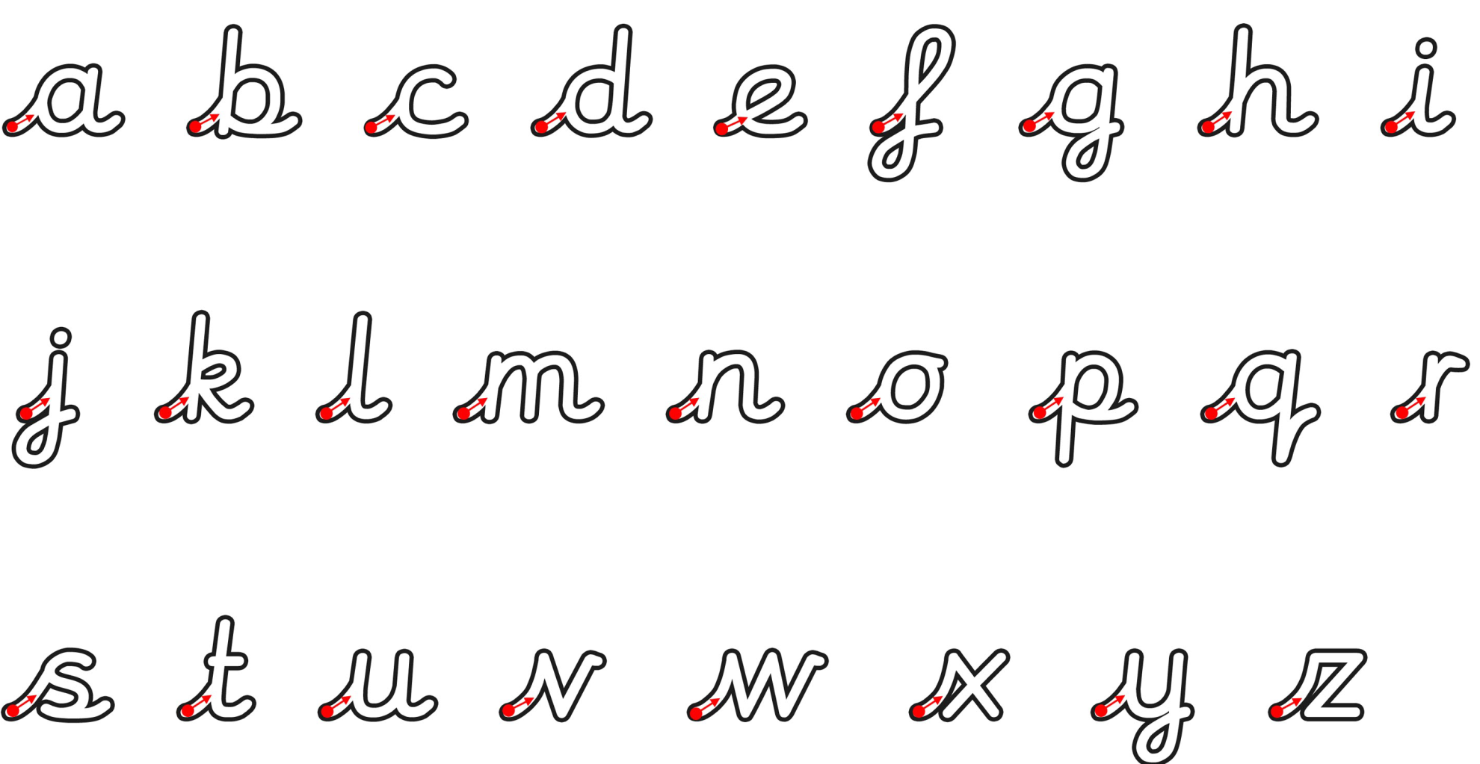
Please do take a letter formation sheet as you go.

Slide 15
How can you support your child at home?
Use the sound fans.
Read regularly, not just books but signs, logos, magazines...
Word books.
Practise, practise, practise!

Slide 16
Useful websites:
www.jollylearning.co.uk
www.phonicsplay.co.uk
www.ictgames.com
www.oxfordowl.co.uk
https://www.youtube.com/watch?v=BqhXUW_v-1s

Slide 17
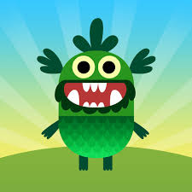
Useful Apps
Teach your monster to read (currently free!)
Jolly Phonics Letter Sounds £4.99

Slide 18
Any questions?

