Slide 1
Writing in the Early Years
Presented by: Mrs Crowley and Mrs Serle

Slide 2
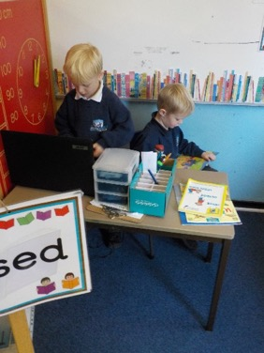
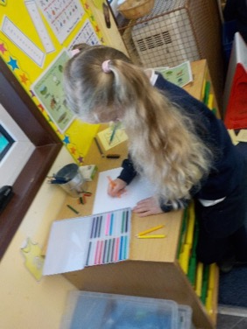
Early Learning Goal for writing
Children use their phonic knowledge to write words in ways which match their spoken sounds. They also write some irregular common words. They write simple sentences which can be read by themselves and others. Some words are spelt correctly and others are phonetically plausible.

Slide 3
Stages of writing Development
Mark Making – scribbles, drawing shapes and lines.
Emergent writing – writing groups of random letters
Labels and names – begin to write and copy own name and recognisable labels.
Writing using initial or dominant sounds.
Writing simple sentences

Slide 4
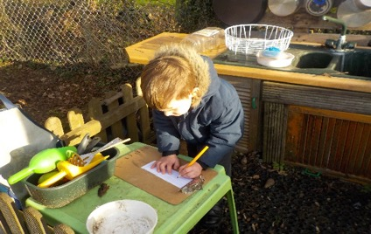
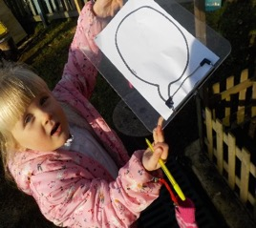
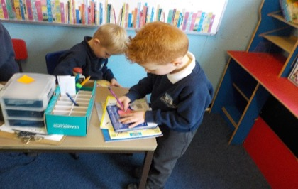
How we encourage confident writers at AK?
We aim to create an environment that reflects the importance of language.
We make sure children see adults modelling writing constantly. – messages, labels, sentences and stories.

Slide 5
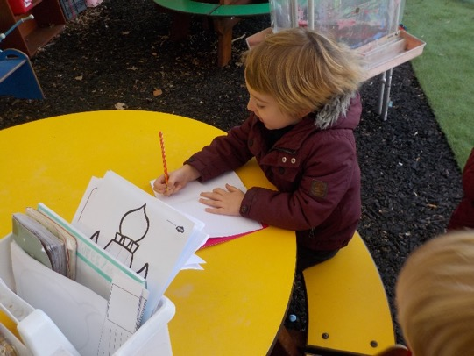
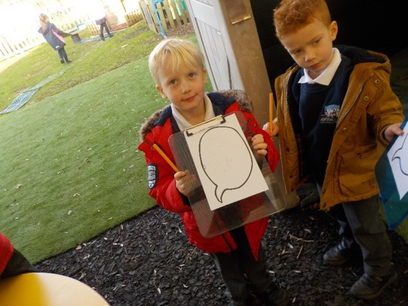
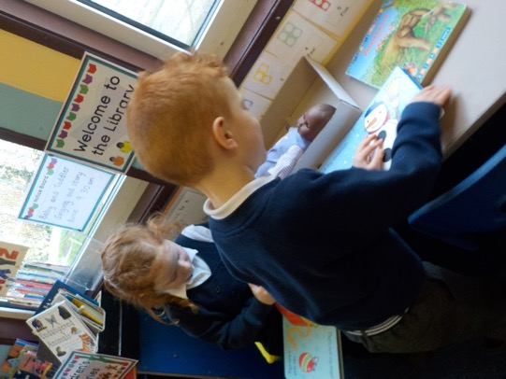
Continued…
How we encourage confident writers at AK?
We create as many opportunities as possible for children to experiment or have a go at writing themselves. For example, in our role play areas, using writing toolboxes and tool belts, our writing table, easels and chalk/white boards outside and clipboards everywhere! It should be part of their play and based upon real experiences.

Slide 6
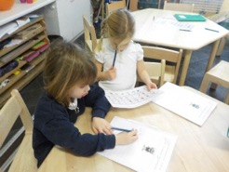
How do we teach writing at AK?
Twice a week we have handwriting sessions where we teach the correct formation of letters.
This term we have started teaching writing to the whole class twice a week. This will increase throughout the rest of the year.
We make sure that all writing is purposeful. For example, a message to an alien, a shopping list, instruction for another class.
We talk to the class and ask them to verbally plan what they will be writing.
We model some shared writing.
The children then create their own writing in their books. The writing will have different levels of challenge and children are supported throughout.
We give them mountains of praise to encourage them to feel proud of their work.

Slide 7
Writing is not just about phonics and formation….
Children need a wide range of skills to move from the simple writing of sentences towards creating stories and poems.
There is a clear link between language development/acquisition and composition/writing.
Before a child can write a story they must be able to retell a story. (See video)
When listening to stories and poems is a regular part of daily life, children have a living library of stories and sentences to spark their imaginations – building blocks that can be used to imagine and invent new narratives.

Slide 8
Talk for Writing - Pie Corbett
An approach based upon how children learn language through
Imitation – listening to, joining in with and retelling simple tales. Use of story maps, actions and language patterns such as ‘once upon a time’.
Innovation – playing with the story, changing the characters, setting or events in groups or with the whole class.
Invention – making up their own stories independently. These can be recorded in different ways: map making, writing, puppets.
By first developing composition orally the act of writing far easier for emergent writers.
Schools that use Talk for writing have seen a dramatic influence on progress in language development and writing – let’s have a go!

Slide 9
How can you support your child at home?
Immerse your child in stories: bedtime stories, fairy tales, poems.
Encourage your child to retell the stories they have learnt at school to you.
Provide opportunities for writing at home, lists, letters, messages, invitations.
Allow your children to make mistakes.
Praise all efforts.

